Slide 1
Next Word Prediction using LSTM & GRU
Minor Project - CDAC Big Data Analytics

Slide 2
Team Members
Team Leader: Sapedi Chetan Swaroop
Prateek Kulshrestha
Rushikesh Pabalkar
Sonu Lad
Abhishek Singh
Anannya Sarkar
Shakyadita Sonawane
Vedika Mule

Slide 3
Problem Statement
Predict the next word in a given sentence.
Enhance contextual understanding using deep learning.
Application in text generation, chatbot development, autocomplete systems.

Slide 4
Dataset Description
Source 1: Data related to Bhopal Gas Tragedy.
Source 2: Text corpus from books/public sources.
Combined dataset for richer context and vocabulary.
Preprocessing: Tokenization, Lowercasing, Removal of Punctuations.

Slide 5
Model Architecture
LSTM Model:
Embedding Layer
LSTM Layer
Dense Layer with Softmax Activation
GRU Model:
Similar to LSTM with GRU Layer instead
Used categorical cross-entropy loss & Adam optimizer

Slide 6
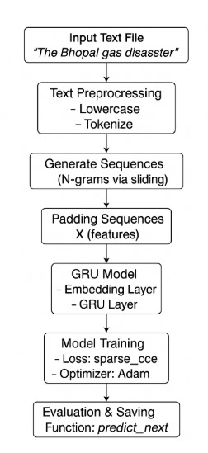
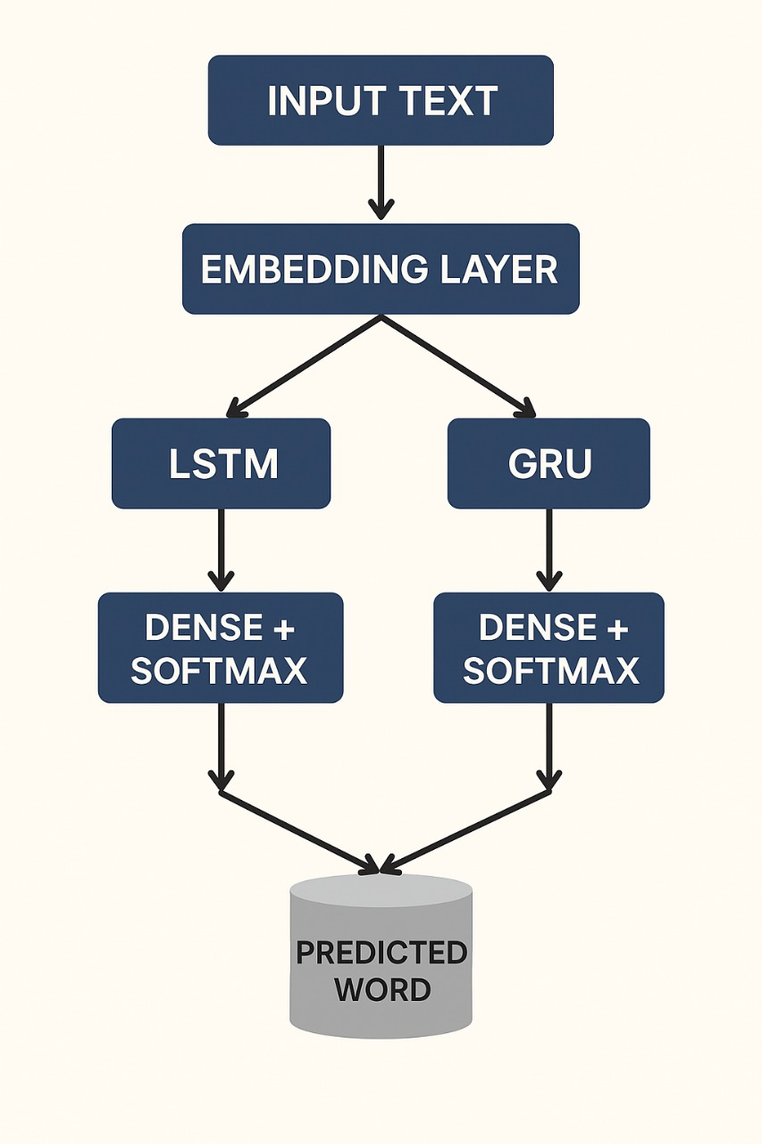
ARCHITECTURE DIAGRAM
MODEL ARCHITECTURE DIAGRAM

Slide 7
Workflow
Data Collection
Data Preprocessing
Tokenization & Sequence Creation
Model Building (LSTM & GRU)
Training & Evaluation
Prediction Interface using Flask

Slide 8
Model Evaluation
Metrics Used: Accuracy, Loss
LSTM Training Accuracy: ~78%
GRU Training Accuracy: ~80.5%
Graphs: Training vs Validation Loss
Confusion matrix for generated vs actual tokens (for evaluation purpose only)

Slide 9
Performance Comparison
LSTM:
Pros: Better long-term memory
Cons: Computationally heavy
GRU:
Pros: Faster training, fewer parameters
Cons: Slightly less accurate
Visual Comparison: Bar Chart (Accuracy, Time)

Slide 10
Learning Outcomes
Gained hands-on experience with deep learning models (LSTM & GRU).
Understood the complexity of Natural Language Processing (NLP) tasks.
Explored dataset preparation, text preprocessing, and tokenization techniques.
Learned to evaluate models using metrics like accuracy, loss.
Developed a collaborative mindset through team-based project execution.
Practiced integration of book and real-world text data (Bhopal Gas Tragedy + Literature).

Slide 11
Conclusion
Successfully implemented a Next Word Prediction system using LSTM and GRU models.
Demonstrated how AI can assist in language generation using historical and literary data.
Built a working NLP pipeline from dataset collection to deployment-ready prediction.
The project reinforced the importance of data quality, model selection, and teamwork in real-world AI applications.

Slide 12
